Slide 1

Best Practices for Reopening Schools
Cynthia Saunders, Superintendent
Dr. Scott L. Hopes, Board Member
August 24, 2020

Slide 2

Five Day Live Instruction Plan for Reopening
Grades PreK-6 & K-8 Schools
All students return
A five-day instructional hybrid schedule integrating
on-campus learning with eLearning
eLearning Manatee
Students can choose to receive full time eLearningManatee instruction with full array of school services
to on-campus
learning following a traditional five-day schedule
Grades 7-12
Opt-in Options for All Grade Levels:
Option A: 5-day on campus
Option B: 5-day hybrid (mix of on campus & eLearning Manatee)
Option C: 5-day eLearning Manatee

Slide 3
Average Enrollment Data
Hybrid
eLearning
Brick & Mortar
Elementary
4%
27%
69%
Middle
27%
27%
46%
High
49%
22%
29%
9,688
10,299
20,160
Total K-12
24%
26%
50%
Data derived from parent survey with over 20,000 responses

Slide 4
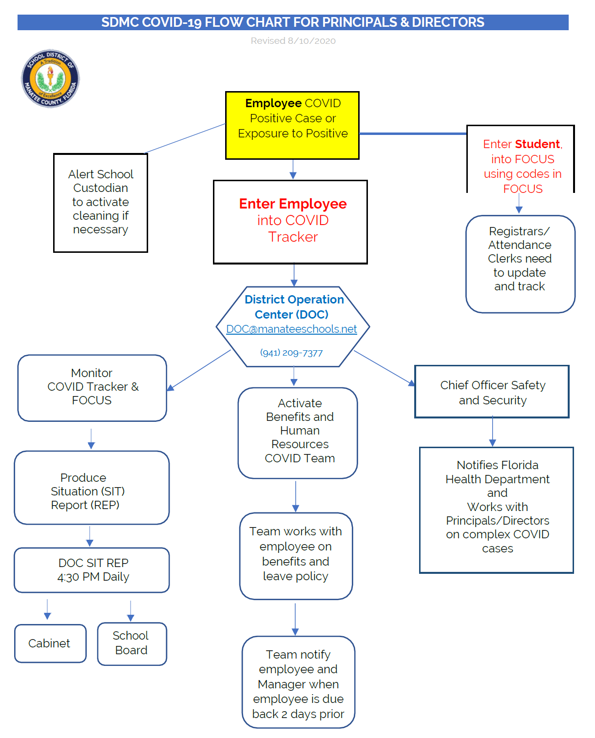
DOC – District Operations Center
Process:
Principal/Director/SLT/District Office Administration must contact the DOC via email or telephone to initiate Covid-19 Report of Positive or Exposure involving staff and/or students
Health Department EPI Team to assist with contact tracing and DOC Staff to monitor Tracker and Focus
Communications Department to assist with ConnectEd Messaging
Notes:
The DOC will provide a central location of authority and information and allows for face-to-face coordination among personnel who must make emergency decisions during this Covid-19 Pandemic.
The DOC serves as the central clearinghouse for information collection and coordination of response, establishment of priorities and recovery resources for the incident. Accurate information regarding the situation will facilitate the effectiveness of the overall response and recovery of the operation and for tracking employees and students during this Pandemic.
The DOC will also serve as an interagency Unified Command Post to achieve unity of effort for all responders including the Health Department.

Slide 5
Face Mask Policy & Operating Protocols
Policy 8450 – Control of Casual-Contact Communicable Diseases
“
Therefore, in order to implement immediate mitigation measures during this pandemic, the School Board hereby mandates that all employees, visitors, and students wear a face mask while on school property, facilities, school buses and/or engaged in school activities in accordance with the District’s policies, procedures, and protocols, outlined in the Centers for Disease Control and Prevention (“CDC”) current guidance1 as well as all applicable laws, including the Americans with Disabilities Act, as amended, 42 U.S.C. § 12101, et seq., § 504 of the Rehabilitation Act, as amended, 29 U.S.C. § 794, the Individuals with Disabilities Education Act, 20 U.S.C. § 1400, et seq. and/or any other applicable federal, state or local law.
“
Operating Protocols for Policy 8450
“
There are limited circumstances when an alternative face covering is permitted by the Centers for Disease Control and Prevention (CDC) in lieu of a face mask in school settings set forth in guidance dated August 11, 2020 titled “Guidance for K-12 School Administrators on the Use of Cloth Face Coverings in Schools”
“
Mask waiver available by contacting District General Counsel
A waiver does not mean that the student or staff will not wear anything.

Slide 6
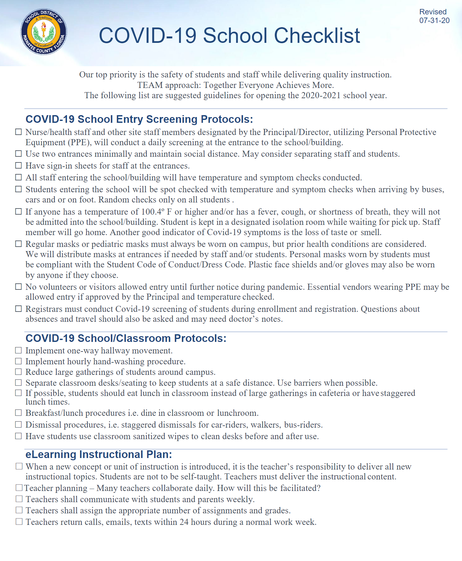
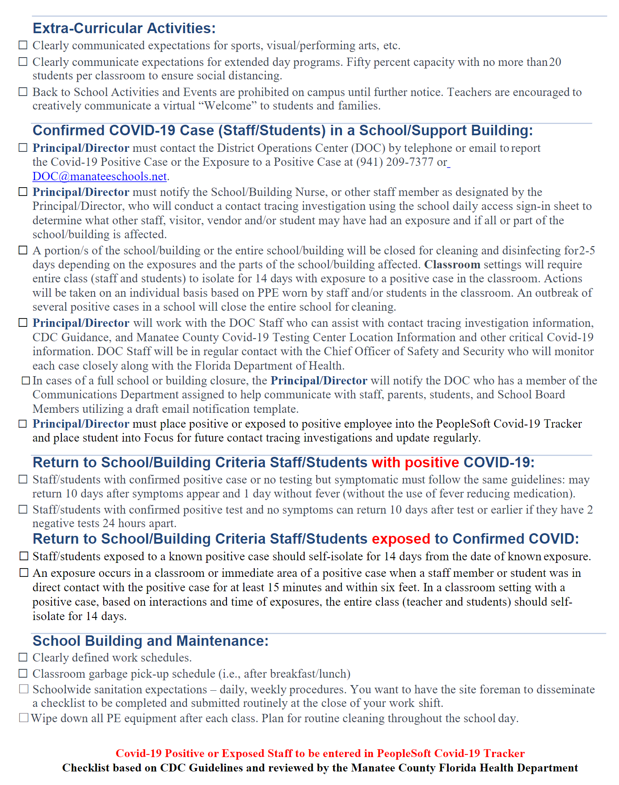
Internal COVID-19 School Checklist

Slide 7
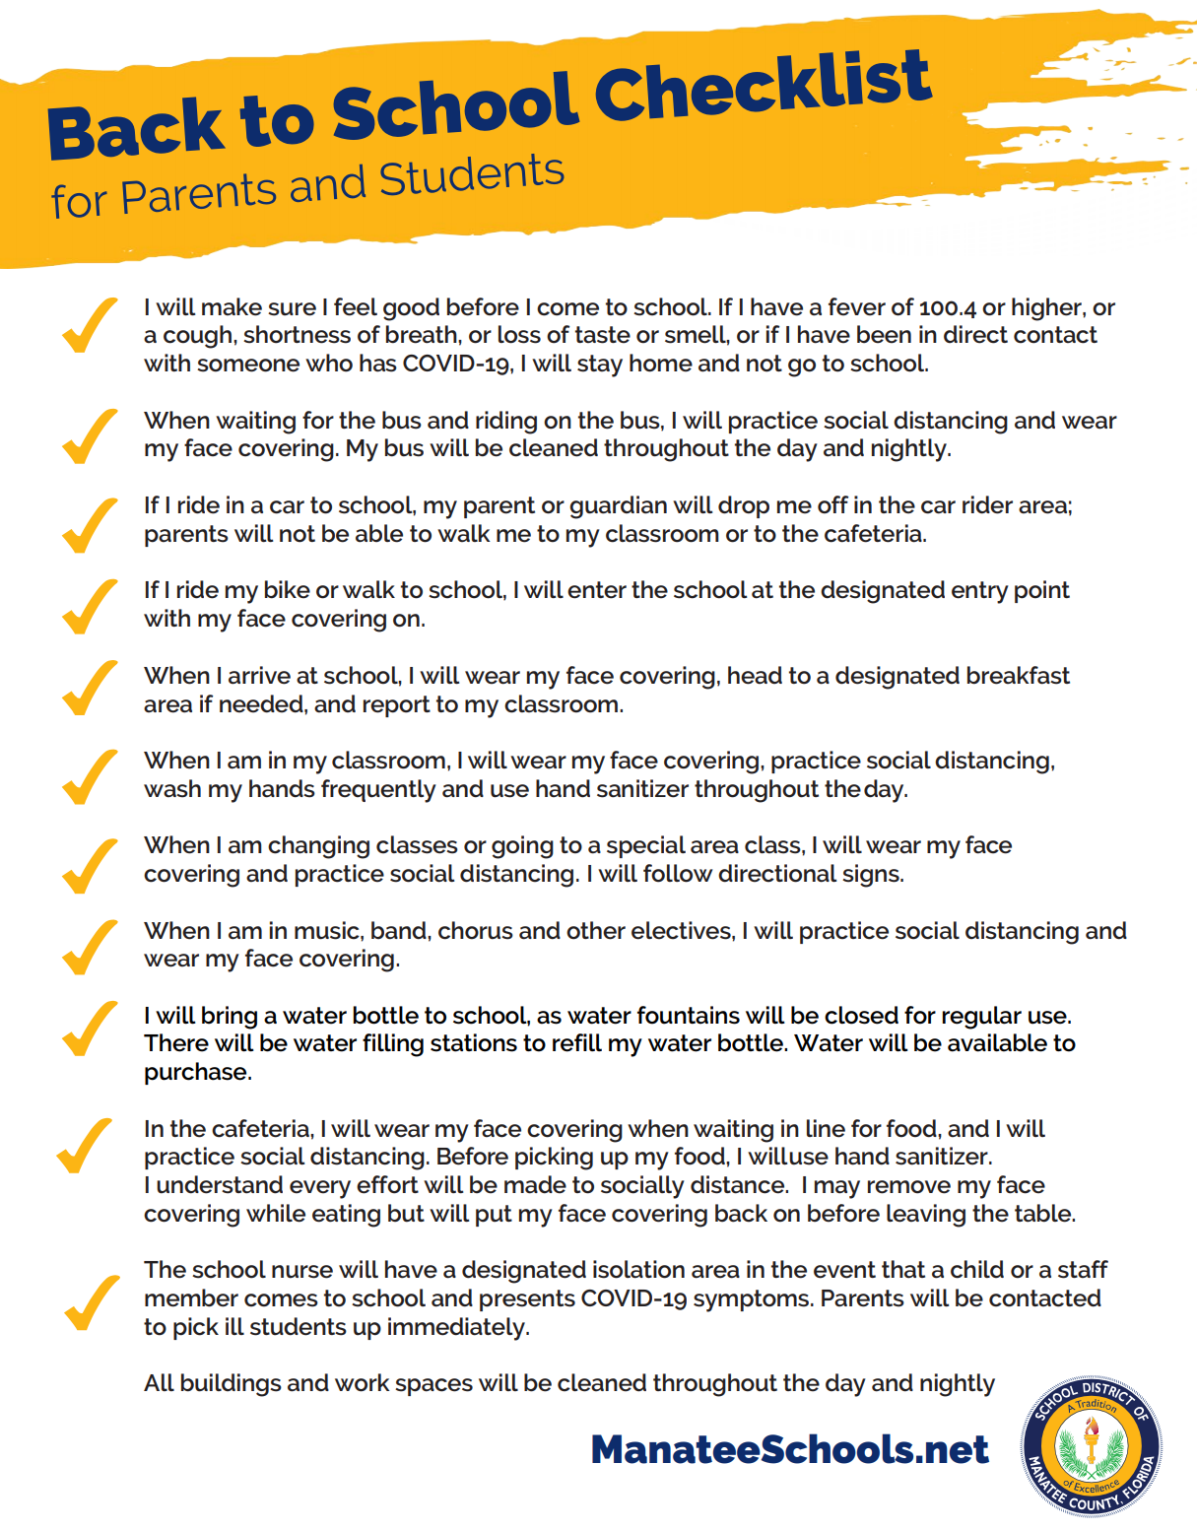



Back to School Checklist
K-12
Post Secondary

Slide 8


Student & Staff Daily Questionnaire
Are you sick with flu-like symptoms?
Have you or someone living in your house been tested in the last 14 days due to a confirmed COVID-19 exposure or symptoms?
Have you been exposed to a positive COVID-19 case in the last 14 days?
Do you have any COVID-19 symptoms?
Have you or a family member been tested for COVID-19 in the last 14 days due to a confirmed COVID-19 exposure or symptoms?
Have you been exposed to a (positive) COVID-19 case in the last 14 days?

Slide 9
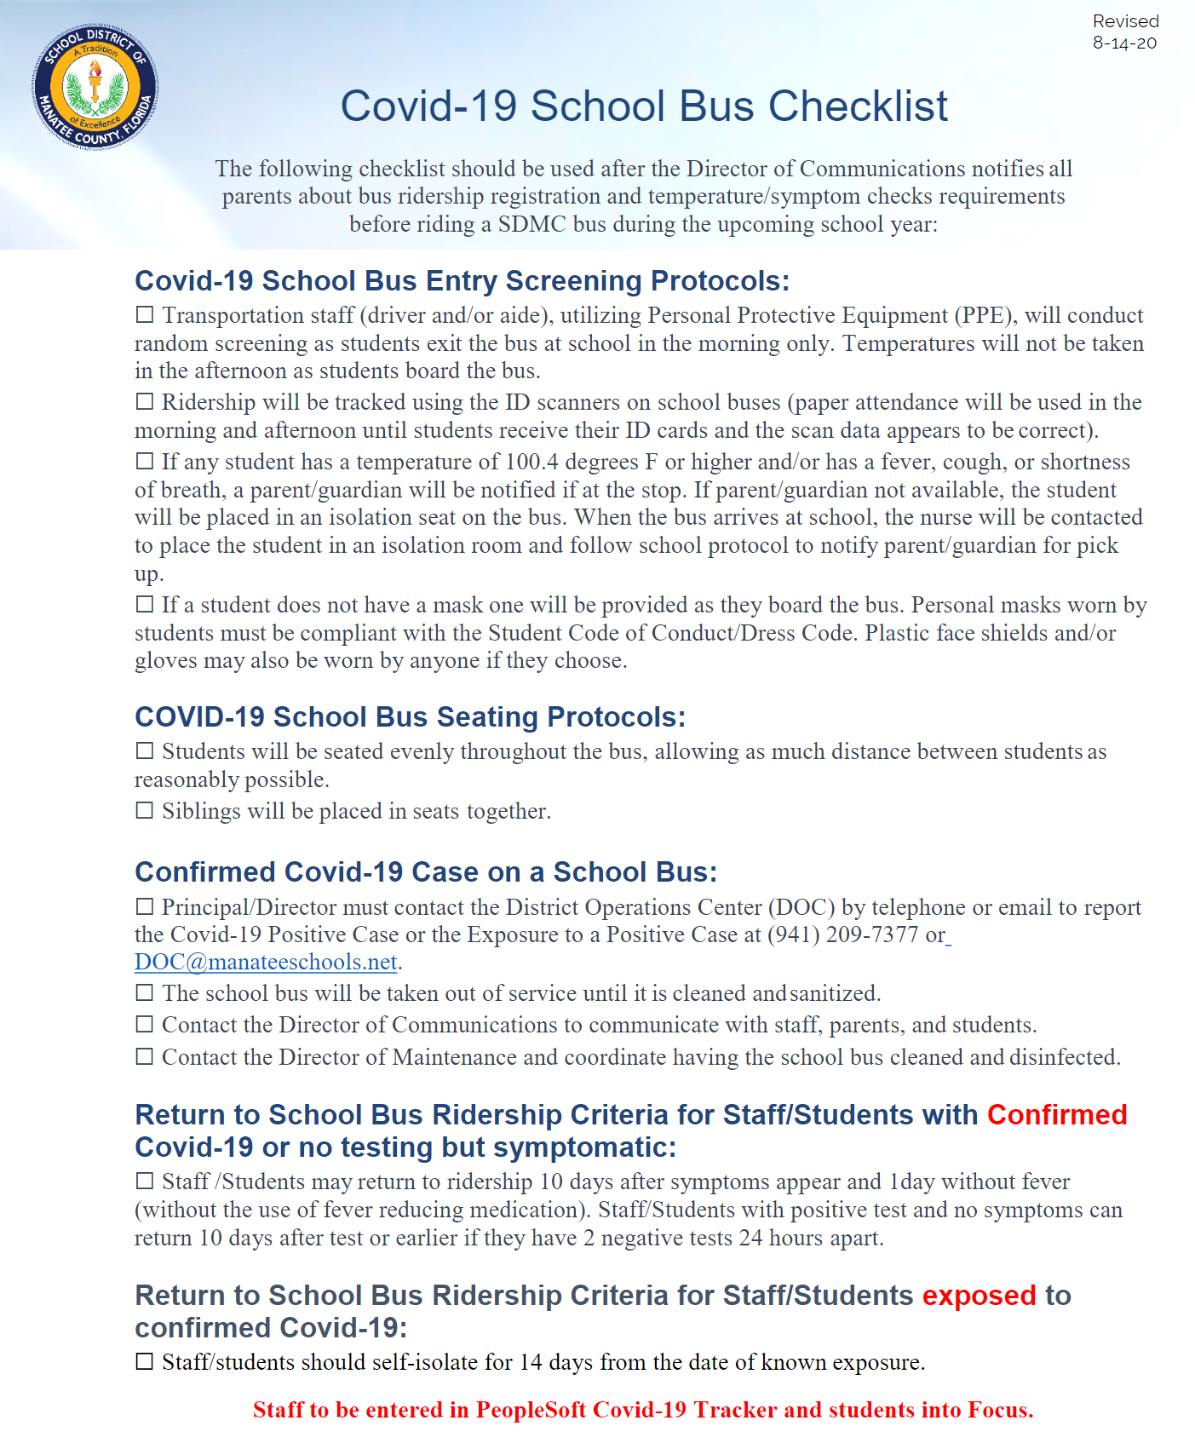
Safety Protocols
Temperature Checks
  Random for students
  Required daily for employees
Transportation
  Each bus has hand sanitizer
  Daily cleaning protocols and procedures will be enacted in between routes
Isolation Room
  Each school has a room separate from the clinic if they have COVID like symptoms or a positive answer to the attestation questions
Social Distancing
  Room set up
  Plexi glass dividers
Limited visitors to a school/district facility
Deep Cleaning
  Product use list with links to chemical information
  Electrostatic Sprayer Machine - Virus Sanitization
  Cleaning Protocols for schools
PPE
  Each school was provided financial resources to purchase PPE supplies in addition to District overall purchases

Slide 10
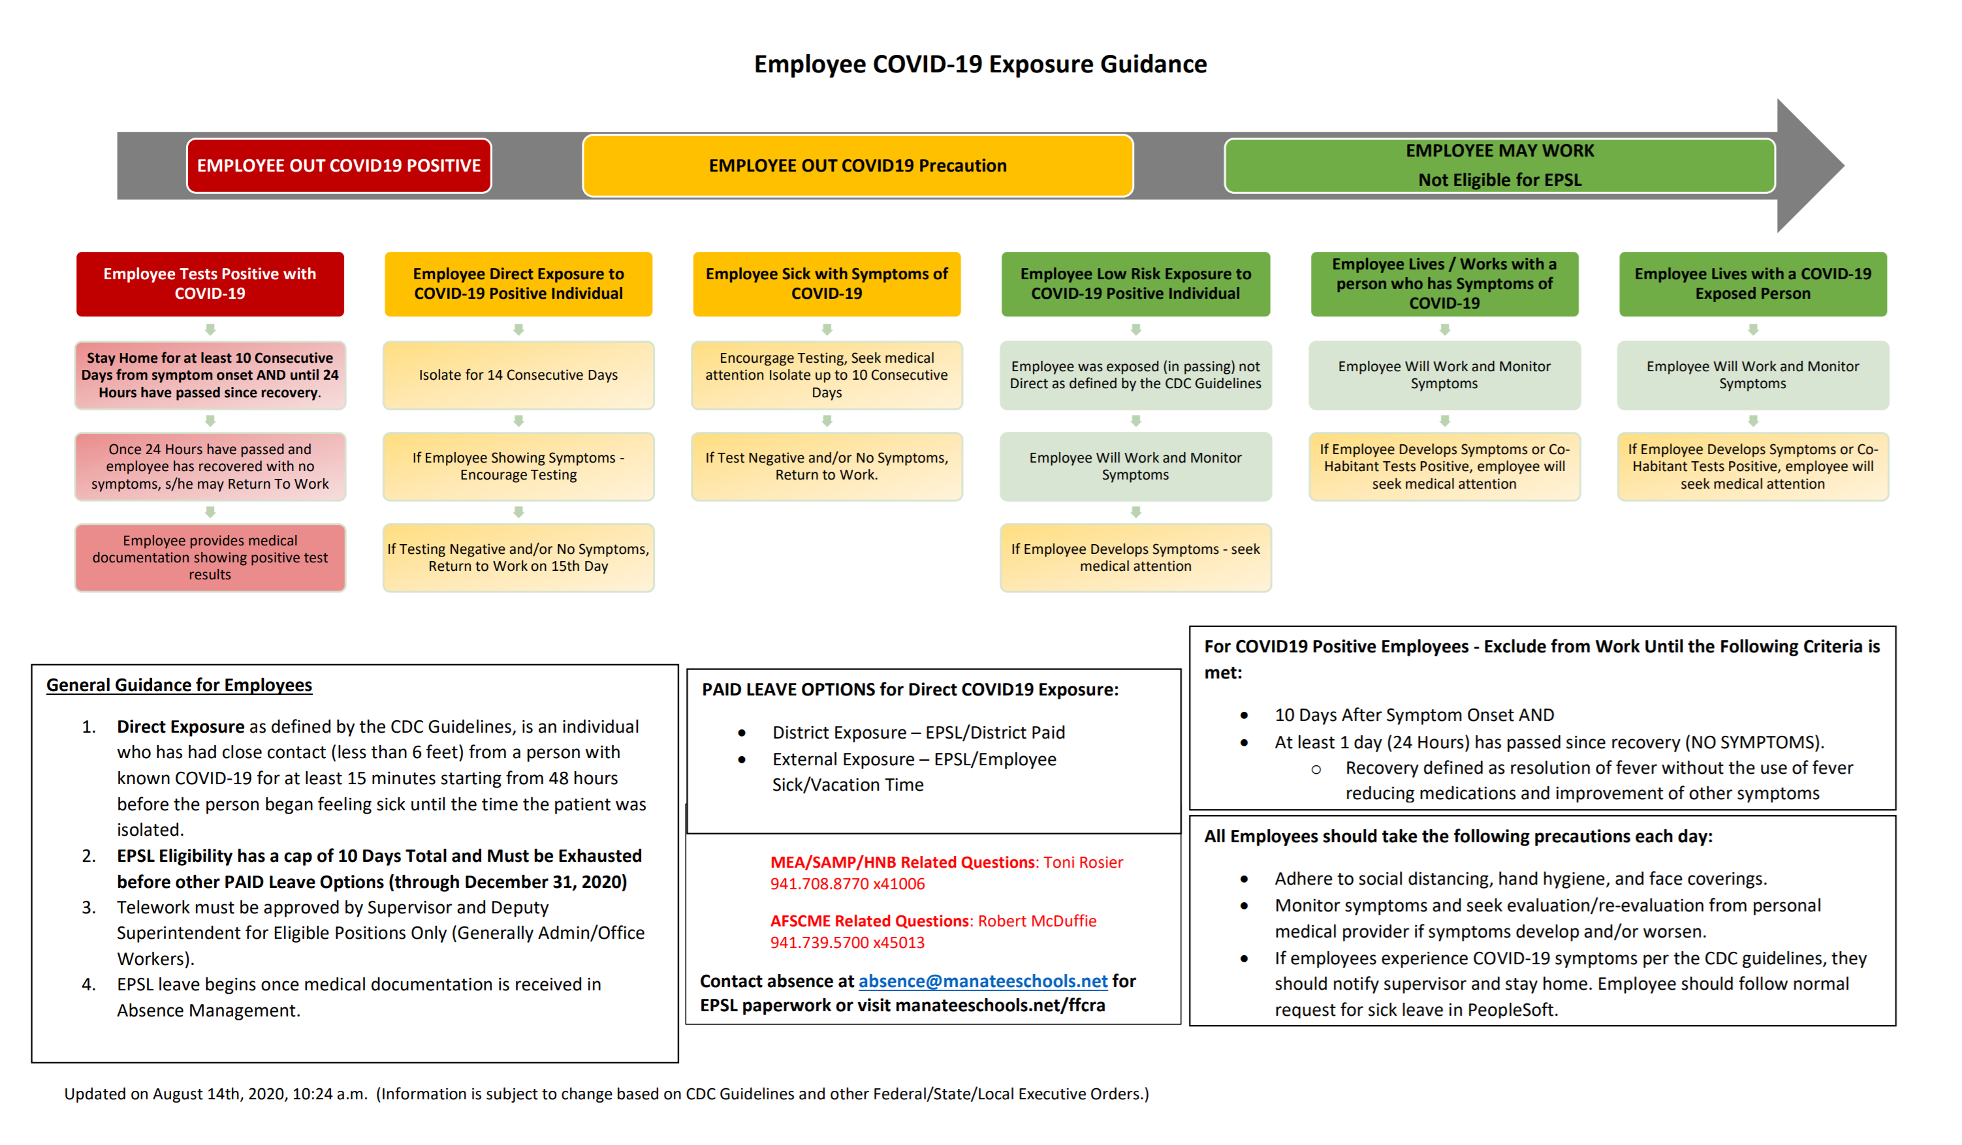
Employee COVID-19 Exposure Guidance

Slide 11
Closures, Partial Closures, Class, individuals
Positive COVID-19 Case of Student or Staff Member
  A portion(s) of the school/building or the entire school/building will be closed for cleaning and disinfecting depending on the exposures and the parts of the school/building affected. Actions will be taken on an individual basis.
  An outbreak of several positive cases in a school(s) may close the entire school/district with health department consultation. If a school/district closes, all students will have live instruction on eLearningManatee and full array of services so there is continuous learning.
  Any students or staff member exposed to a positive is on a 14-day isolation from date of known exposure.
  Exposure occurs when a positive case was in direct contact with a staff member or student for at least 15 minutes.
  May have to isolate entire class for 14 days.
  **Please note: When/If school closure occurs; all students will be required to continue their daily instructional schedule and academic lessons through our eLearningManatee platform. All IEP/ESOL array of services will be provided.

Slide 12

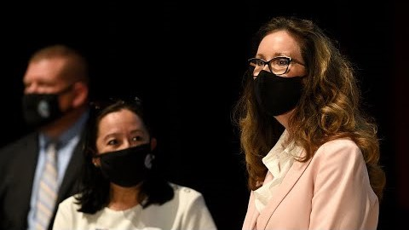



Community Involvement
Combined forces to fight COVID-19 with the Florida Department of Health in Manatee and Manatee County Government Administrator
Notes:
Central focus – encouraging all residents of Manatee County to wear masks when in public – we will also be emphasizing other preventative practices and measures.
Mask Up Manatee is also about educating children on the importance and reasoning behind wearing face masks.
THE REAL POWER OF THIS CAMPAIGN IS IN THE UNITY OF THE MESSAGE AND IN THE UNITY OF THE LEADERS AND ORGANIZATIONS INVOLVED.

Slide 13
We stand stronger when we stand together.
- Cynthia Saunders

